Slide 1
Topic 7.x – Heap Sort

Slide 2
Heap sort
Heap sort is a comparison based sorting technique based on Binary Heap data structure.
It is similar to selection sort where we first find the maximum element and place the maximum element at the end.
We repeat the same process for the remaining elements.

Slide 3
Binary Tree
A tree whose elements have at most 2 children is called a binary tree.
Since each element in a binary tree can have only 2 children, we typically name them the left and right child.
A Binary Tree node contains following parts.
Data
Pointer to left child
Pointer to right child
parent node
children node
children node

Slide 4
Complete Binary Tree
A complete binary tree is a binary tree in which every level, except possibly the last, is completely filled, and all nodes are as far left as possible (Source Wikipedia)
A Binary Heap is a Complete Binary Tree where items are stored in a special order such that value in a parent node is greater(or smaller) than the values in its two children nodes.
The former is called as max heap and the latter is called min-heap. The heap can be represented by a binary tree or array.

Slide 5
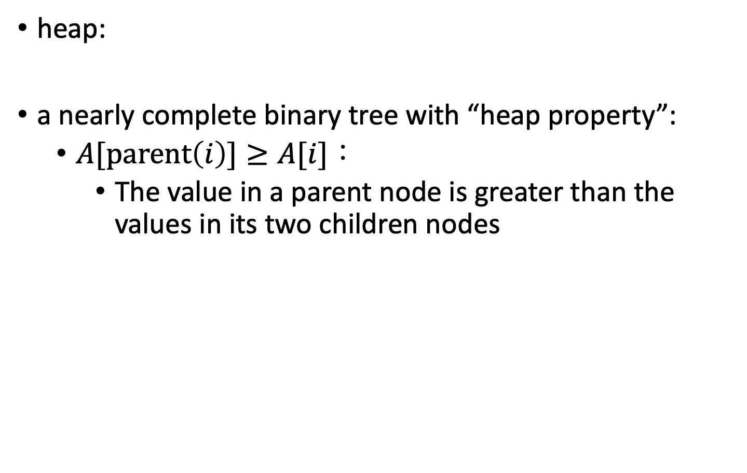
Heap Property
 | 1 | 2 | 3 | 4 | 5 | 6 | 7 | 8 | 9 | 10
A: | 16 | 14 | 10 | 8 | 7 | 9 | 3 | 2 | 4 | 1
heap:
a nearly complete binary tree with “heap property”:
$A[parent\left(i\right)]≥A[i]$：
The value in a parent node is greater than the values in its two children nodes
parent node: greater
children node:
smaller
children node:
smaller

Slide 6
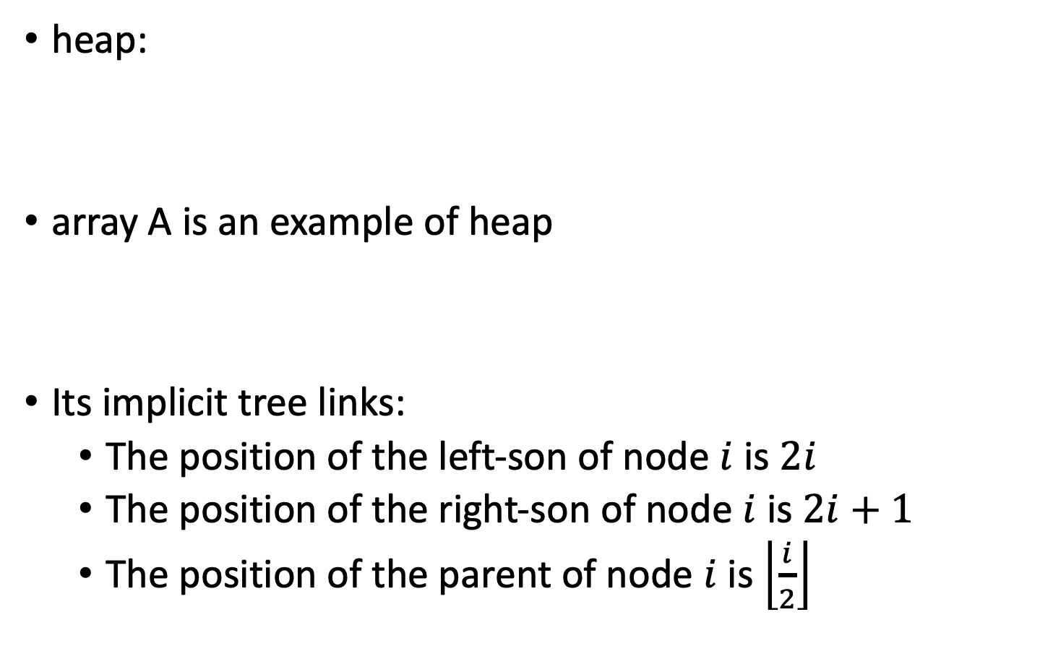
Heap Property
 | 1 | 2 | 3 | 4 | 5 | 6 | 7 | 8 | 9 | 10
A: | 16 | 14 | 10 | 8 | 7 | 9 | 3 | 2 | 4 | 1
heap:
array A is an example of heap
Its implicit tree links:
The position of the left-son of node $i$ is $2i$
The position of the right-son of node $i$ is $2i+1$
The position of the parent of node $i$ is $\left\lfloor \frac{i}{2}\right\rfloor$
1
16
2
3
14
10
4
5
6
7
8
7
9
3
8
9
10
2
4
1

Slide 7
Heap Property
 | 1 | 2 | 3 | 4 | 5 | 6 | 7 | 8 | 9 | 10
A: | 16 | 14 | 10 | 8 | 7 | 9 | 3 | 2 | 4 | 1
heap:
array A is an example of heap
So we can use an array to implement a heap
Problem: Where is the largest element of a heap?
root (at position 1)
1
16
2
3
14
10
4
5
6
7
8
7
9
3
8
9
10
2
4
1

Slide 8
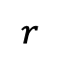
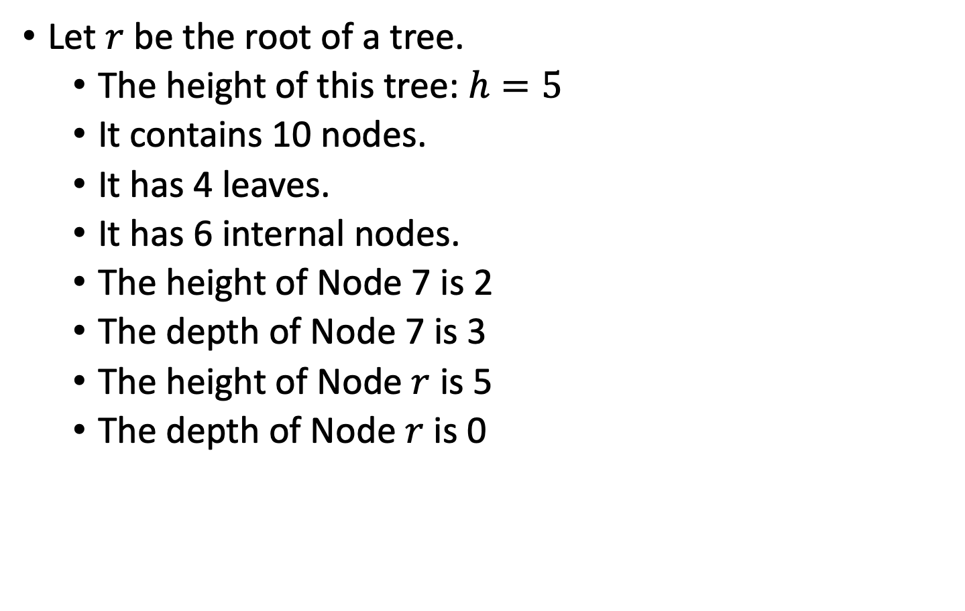
Tree
Let $r$ be the root of a tree.
The height of this tree: $h=5$
It contains 10 nodes.
It has 4 leaves.
It has 6 internal nodes.
The height of Node 7 is 2
The depth of Node 7 is 3
The height of Node $r$ is 5
The depth of Node $r$ is 0
$$r$$
7
height
depth

Slide 9
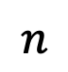
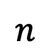
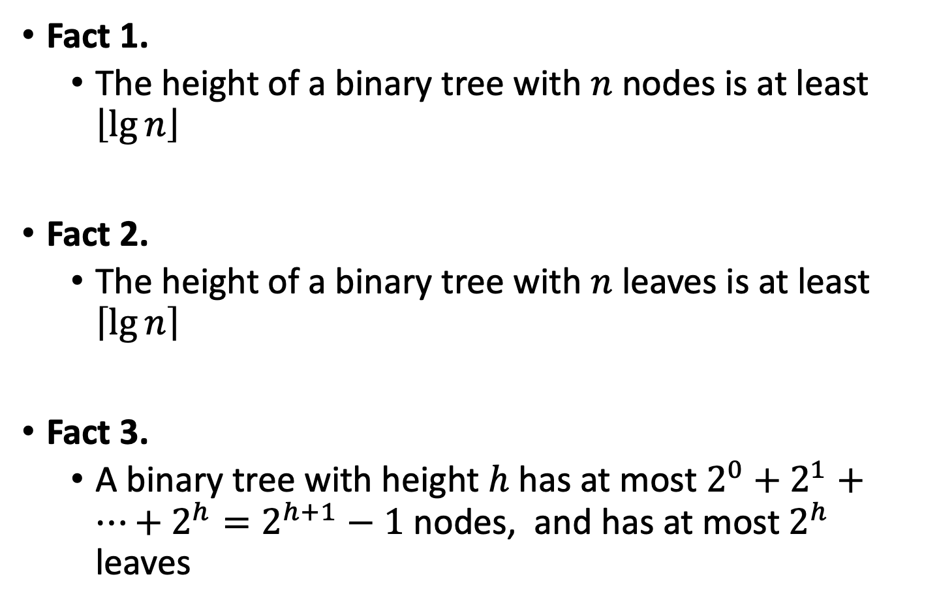

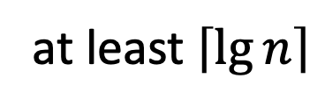
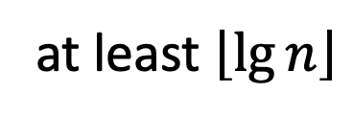
Facts of a Binary Tree
Fact 1.
The height of a binary tree with $n$ nodes is at least $\left\lfloor \lg{n}\right\rfloor$
Fact 2.
The height of a binary tree with $n$ leaves is at least $\left\lceil \lg{n}\right\rceil$
Fact 3.
A binary tree with height $h$ has at most $2^{0}+2^{1}+…+2^{h}=2^{h+1}−1$ nodes, and has at most $2^{h}$ leaves
$$n$$
at least $\left\lfloor \lg{n}\right\rfloor$
at least $\left\lceil \lg{n}\right\rceil$
$$\{$$
$$n$$

Slide 10
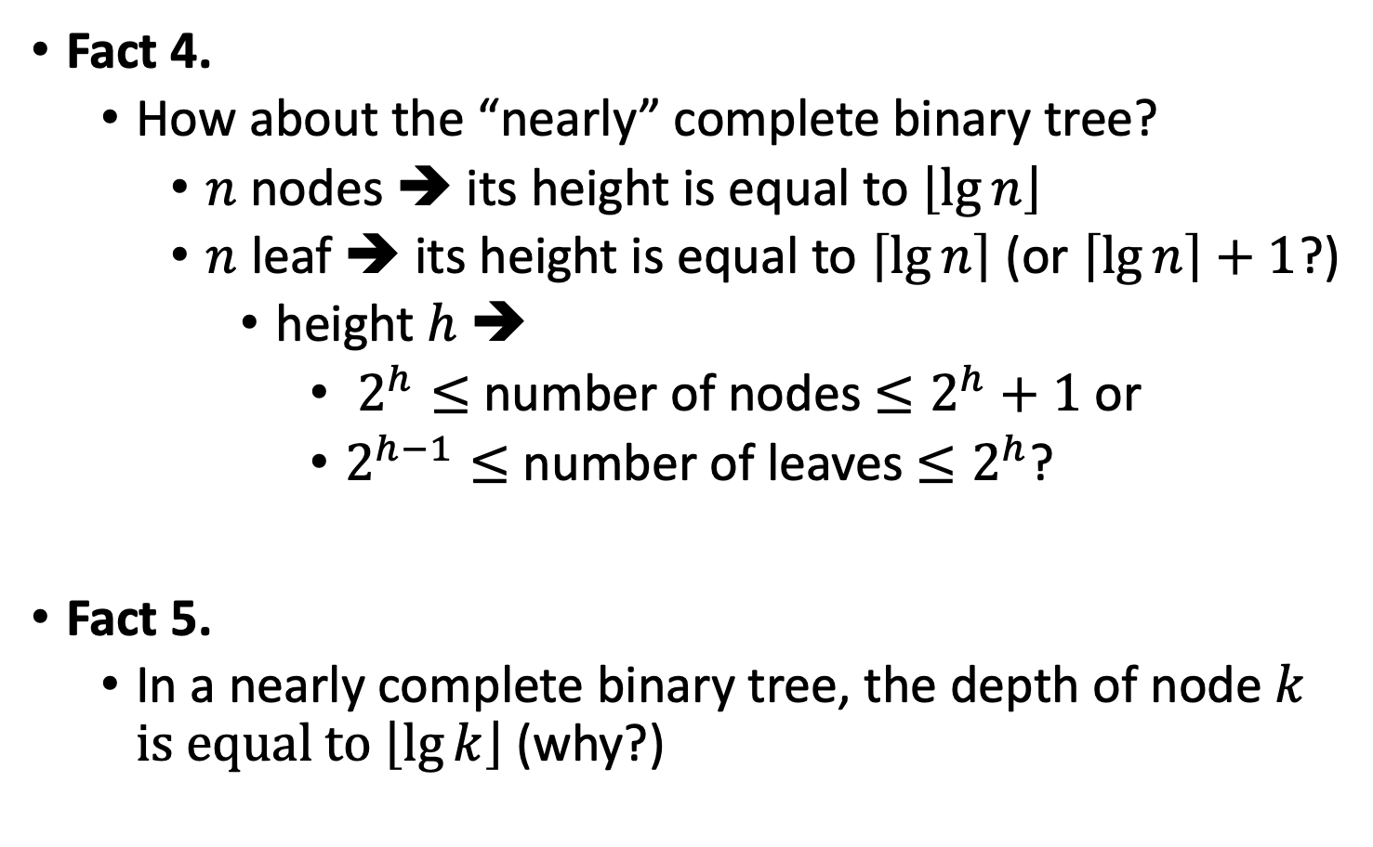
Facts of a Binary Tree
Fact 4.
How about the “nearly” complete binary tree?
$n$ nodes ➔ its height is equal to $\left\lfloor \lg{n}\right\rfloor$
$n$ leaf ➔ its height is equal to $\left\lceil \lg{n}\right\rceil$ (or $\left\lceil \lg{n}\right\rceil +1$?)
height $h$ ➔
$2^{h}≤$ number of nodes $≤2^{h}+1$ or
$2^{h−1}≤$ number of leaves $≤2^{h}$?
Fact 5.
In a nearly complete binary tree, the depth of node $k$ is equal to $\left\lfloor \lg{k}\right\rfloor$ (why?)

Slide 11
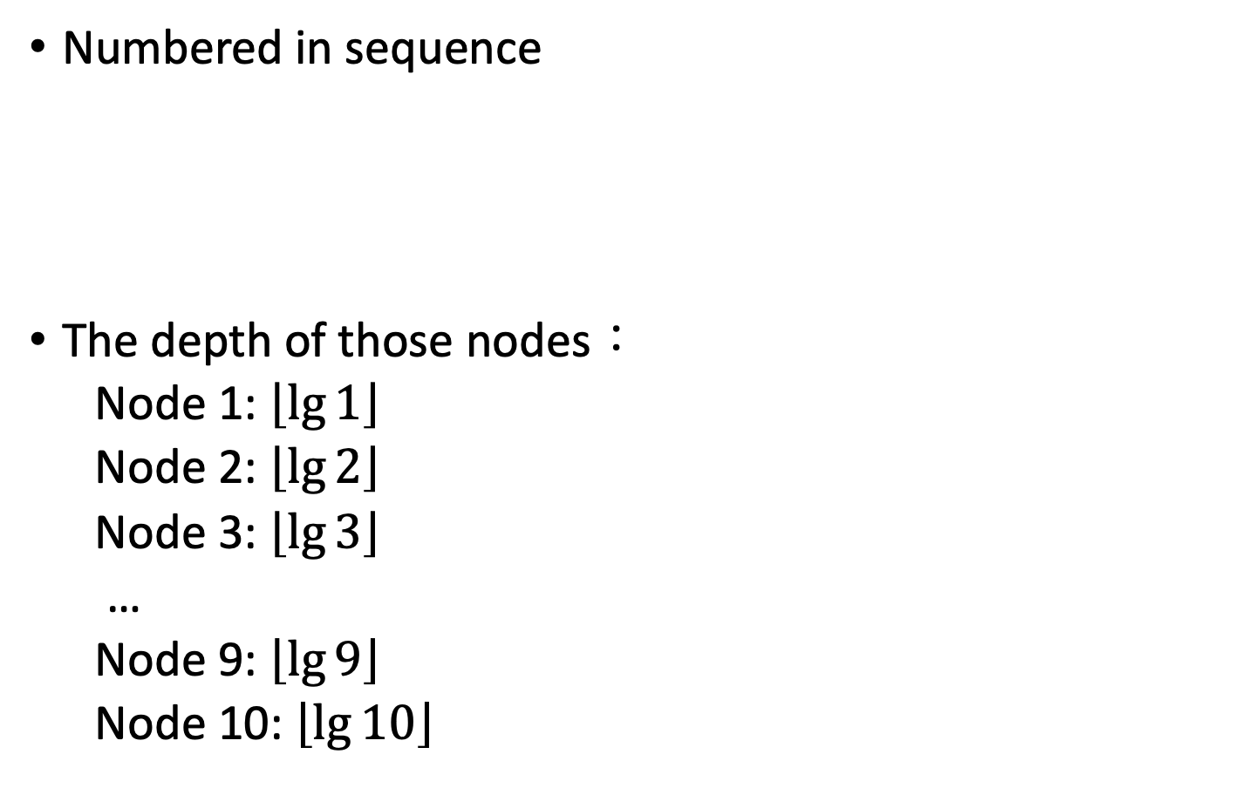
Tree
1
Numbered in sequence
The depth of those nodes：
Node 1: $\left\lfloor \lg{1}\right\rfloor$
Node 2: $\left\lfloor \lg{2}\right\rfloor$
Node 3: $\left\lfloor \lg{3}\right\rfloor$
…
Node 9: $\left\lfloor \lg{9}\right\rfloor$
Node 10: $\left\lfloor \lg{10}\right\rfloor$
2
3
4
5
6
7
8
9
10

Slide 12
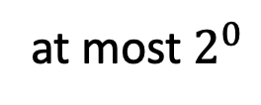
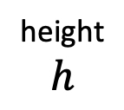
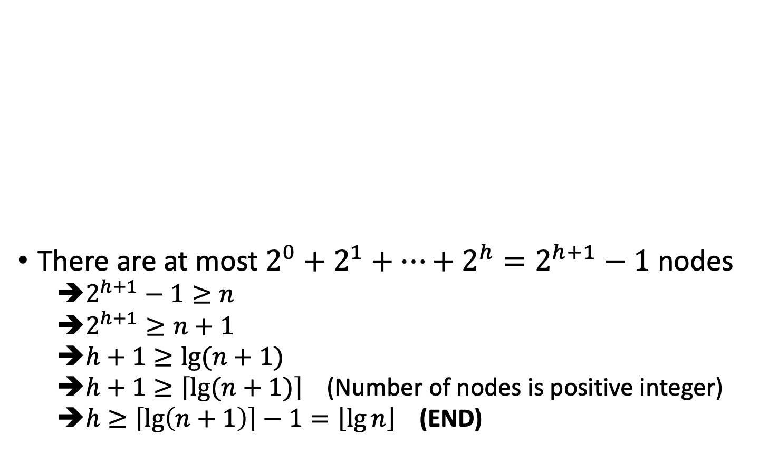
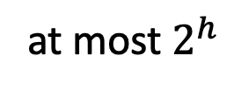
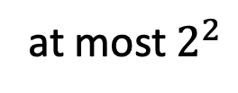
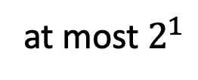
Proof of Fact 1.
at most $2^{0}$
There are at most $2^{0}+2^{1}+…+2^{h}=2^{h+1}−1$ nodes
➔$2^{h+1}−1≥n$
➔$2^{h+1}≥n+1$
➔$h+1≥lg⁡(n+1)$
➔$h+1≥\left\lceil lg⁡(n+1)\right\rceil$ (Number of nodes is positive integer)
➔$h≥\left\lceil \lg\left(n+1\right)\right\rceil −1=\left\lfloor \lg{n}\right\rfloor$ (END)
at most $2^{1}$
height
$$h$$
at most $2^{2}$
at most $2^{h}$

Slide 13
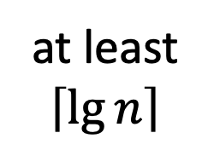
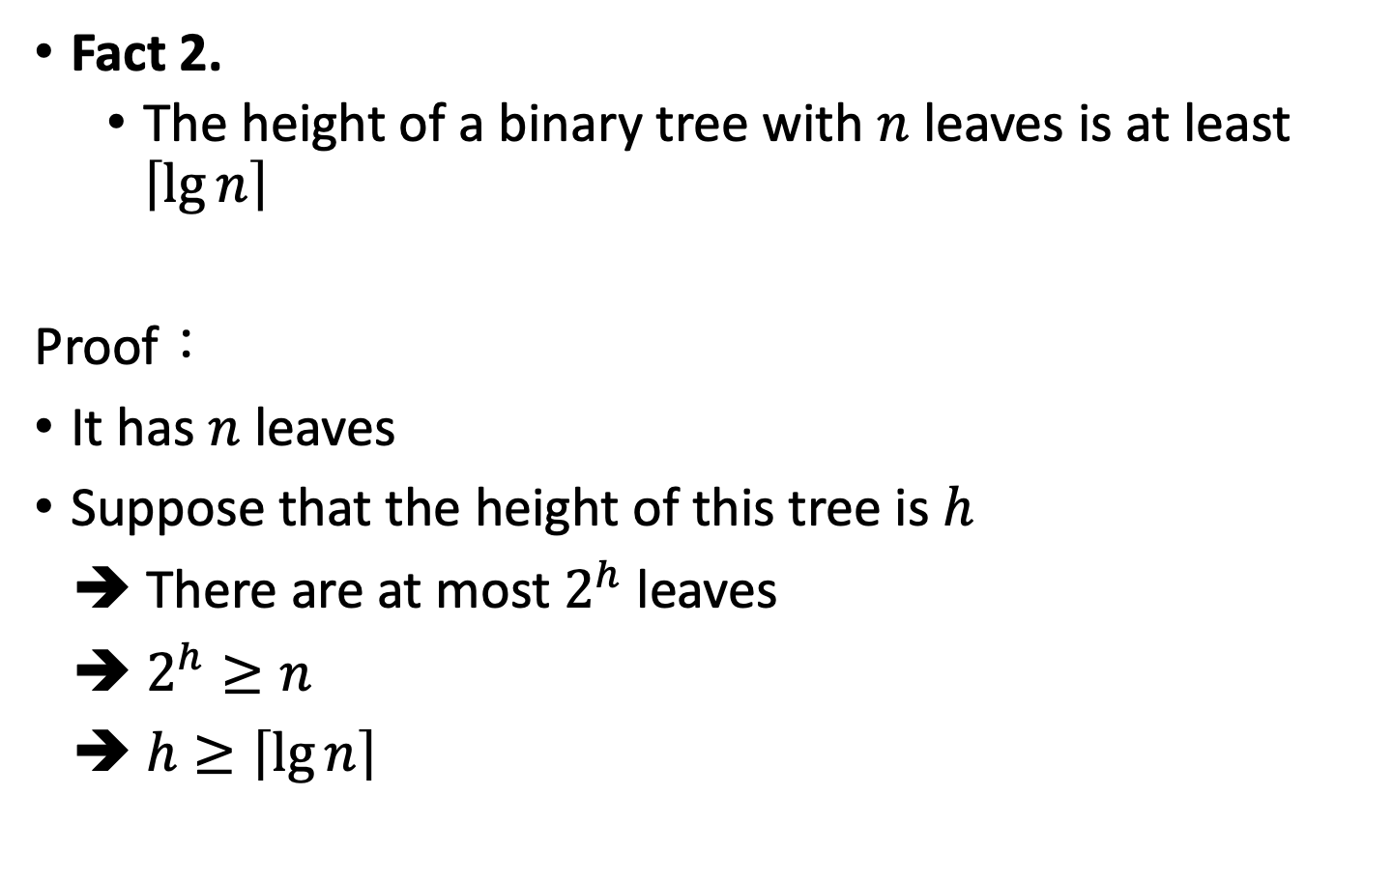
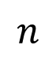

Proof of Fact 2.
Fact 2.
The height of a binary tree with $n$ leaves is at least $\left\lceil \lg{n}\right\rceil$
Proof：
It has $n$ leaves
Suppose that the height of this tree is $h$
➔ There are at most $2^{h}$ leaves
➔ $2^{h}≥n$
➔ $h≥\left\lceil \lg{n}\right\rceil$
at least
$$\left\lceil \lg{n}\right\rceil$$
$$\{$$
$$n$$

Slide 14
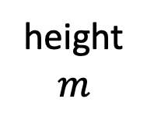
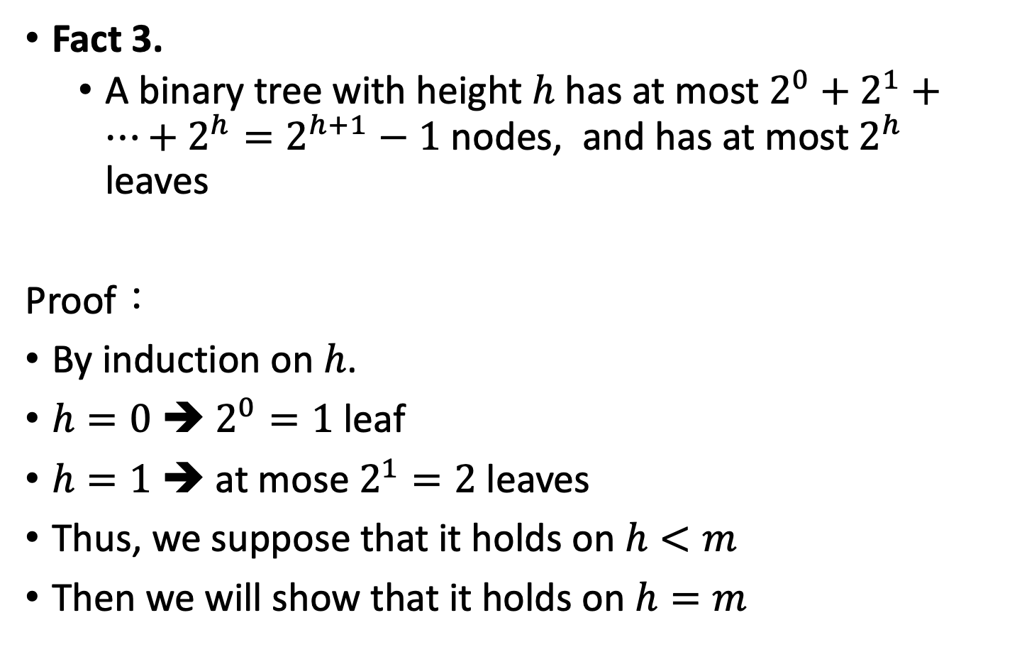
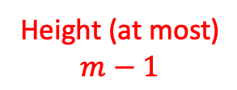
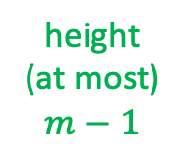
Proof of Fact 3 (ii)
Fact 3.
A binary tree with height $h$ has at most $2^{0}+2^{1}+…+2^{h}=2^{h+1}−1$ nodes, and has at most $2^{h}$ leaves
Proof：
By induction on $h$.
$h=0$ ➔ $2^{0}=1$ leaf
$h=1$ ➔ at mose $2^{1}=2$ leaves
Thus, we suppose that it holds on $h<m$
Then we will show that it holds on $h=m$
height
$$m$$
height
(at most)
$$m−1$$
right
subtree
left
subtree
Height (at most)
$$m−1$$

Slide 15
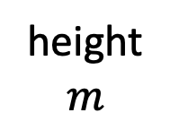
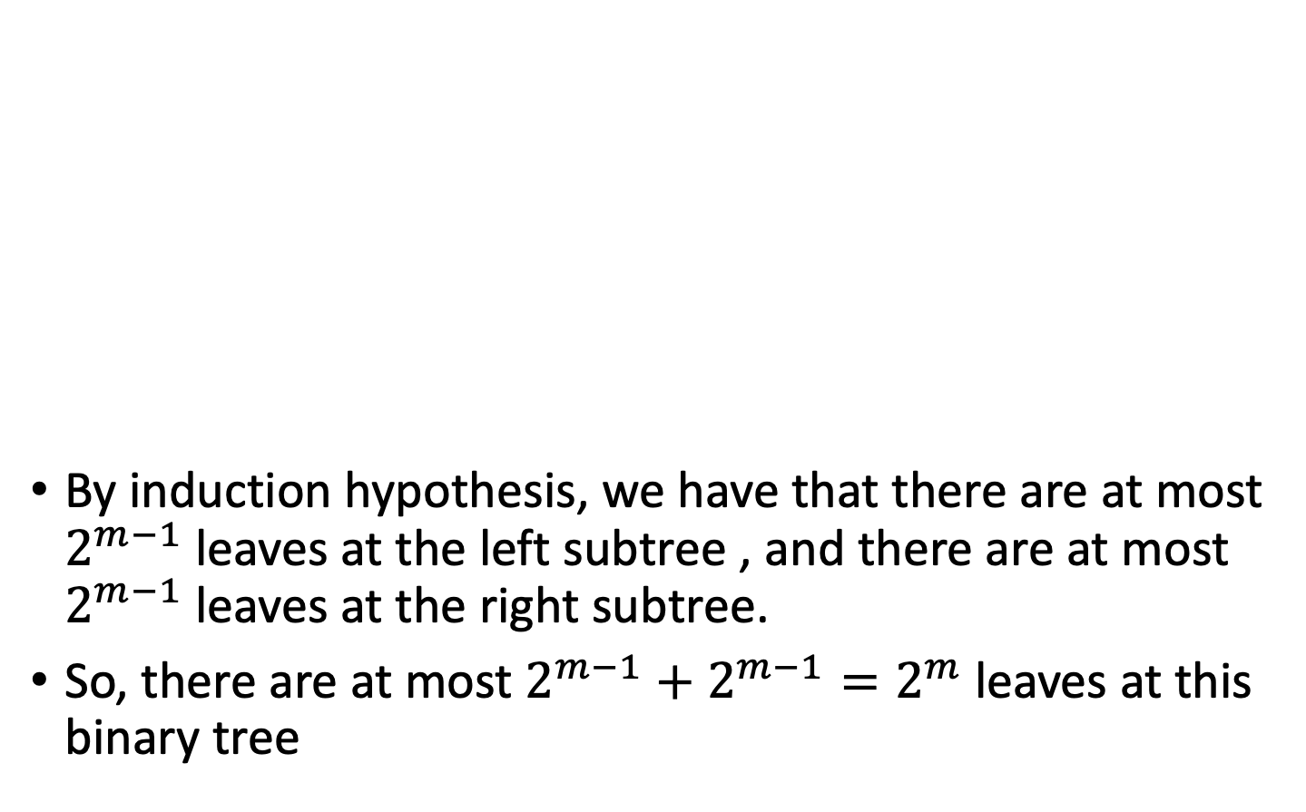
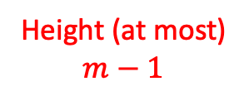
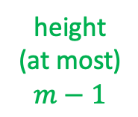
Proof of Fact 3 (ii)
By induction hypothesis, we have that there are at most $2^{m−1}$ leaves at the left subtree , and there are at most $2^{m−1}$ leaves at the right subtree.
So, there are at most $2^{m−1}+2^{m−1}=2^{m}$leaves at this binary tree
height
$$m$$
height
(at most)
$$m−1$$
right
subtree
left
subtree
Height (at most)
$$m−1$$

Slide 16
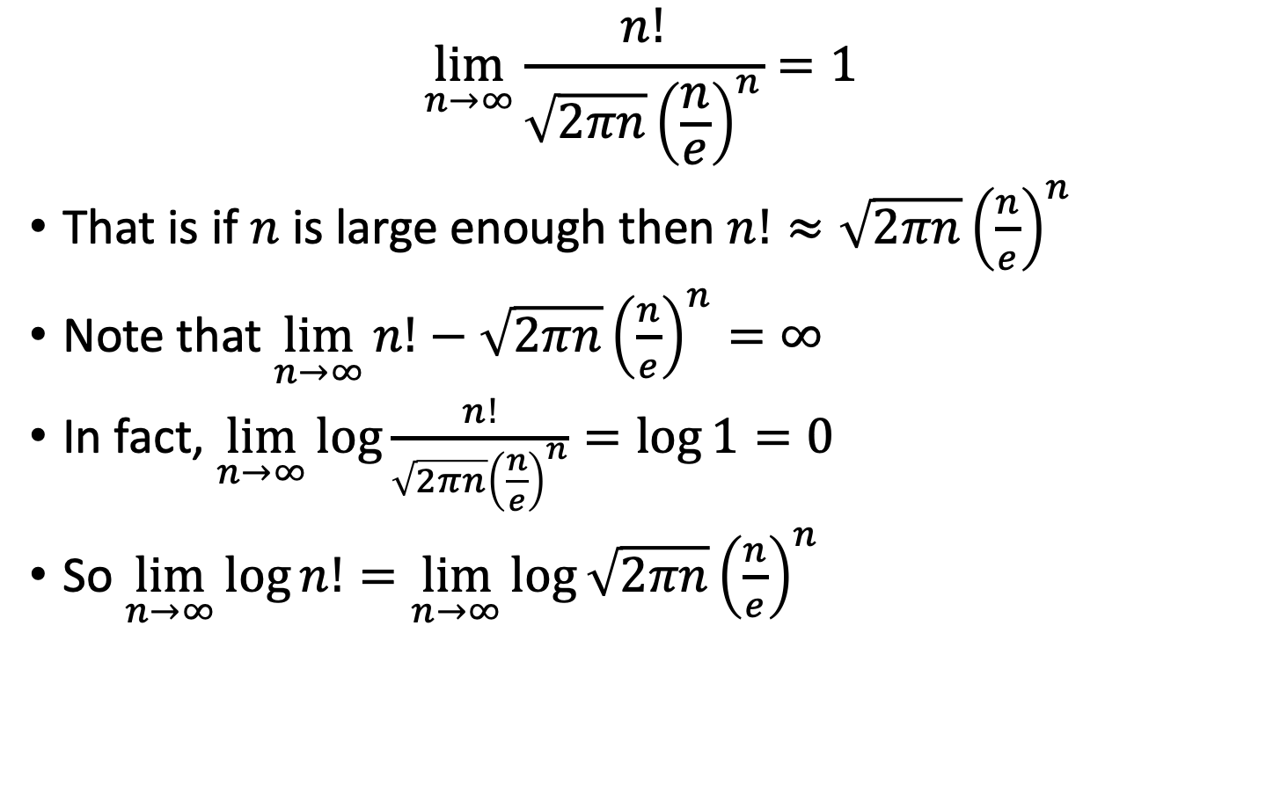
Stirling Formula
$$\lim_{n→∞}{\frac{n!}{\sqrt{2πn}{\left(\frac{n}{e}\right)}^{n}}}=1$$
That is if $n$ is large enough then $n!≈\sqrt{2πn}{\left(\frac{n}{e}\right)}^{n}$
Note that $\lim_{n→∞}{n!−\sqrt{2πn}{\left(\frac{n}{e}\right)}^{n}}=∞$
In fact, $\lim_{n→∞}{\log{\frac{n!}{\sqrt{2πn}{\left(\frac{n}{e}\right)}^{n}}}}=\log{1}=0$
So $\lim_{n→∞}{\log{n!}}=\lim_{n→∞}{\log{\sqrt{2πn}{\left(\frac{n}{e}\right)}^{n}}}$

Slide 17
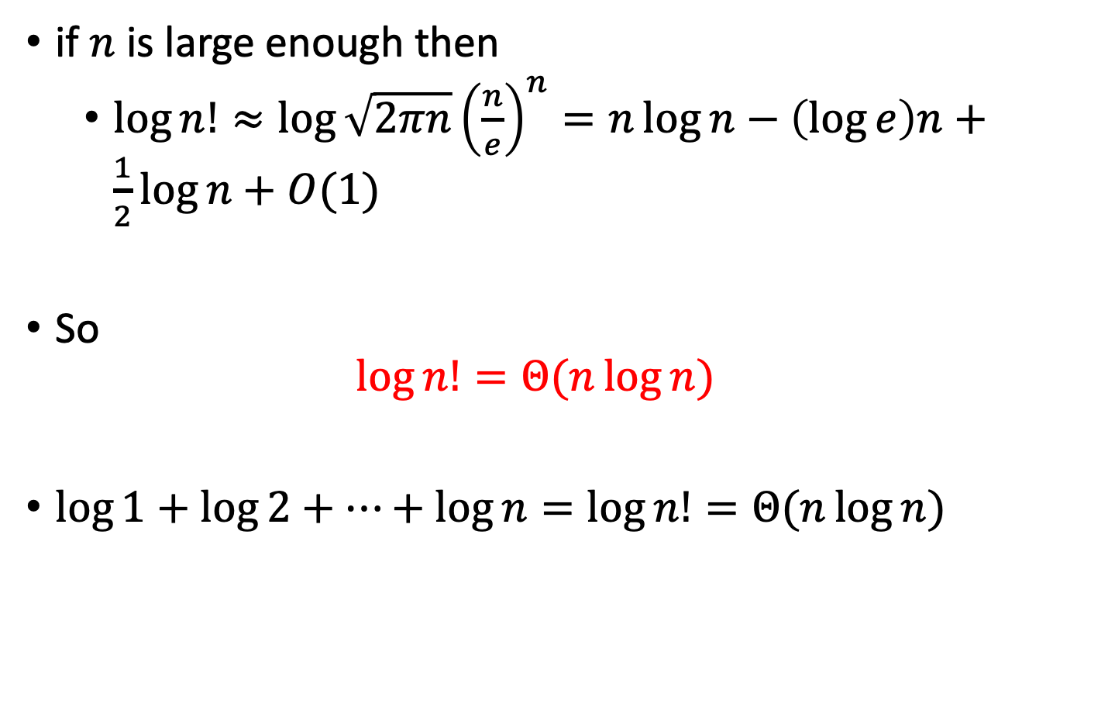
Stirling Formula
if $n$ is large enough then
$\log{n!}≈\log{\sqrt{2πn}{\left(\frac{n}{e}\right)}^{n}}=n\log{n}−\left(\log{e}\right)n+\frac{1}{2}\log{n}+O(1)$
So
$$\log{n!}=Θ(n\log{n})$$
$\log{1}+\log{2}+…+\log{n}=\log{n!}=Θ(n\log{n})$

Slide 18
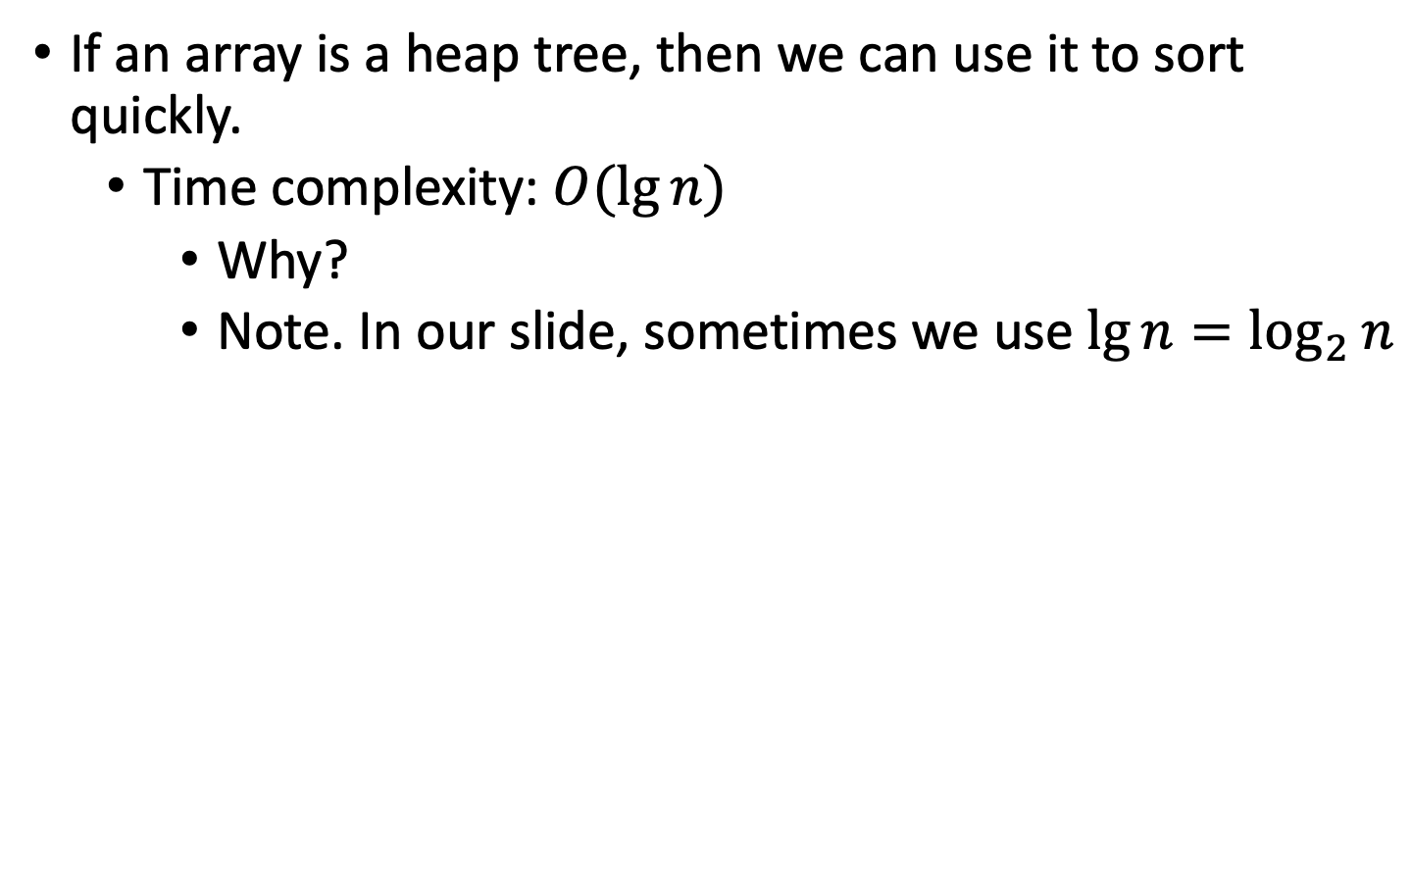
Heap sort
If an array is a heap tree, then we can use it to sort quickly.
Time complexity: $O(\lg{n})$
Why?
Note. In our slide, sometimes we use $\lg{n}=\log_{2}{n}$

Slide 19
Heap sort
Example
(a)
1 | 2 | 3 | 4 | 5 | 6 | 7 | 8 | 9 | 10
16 | 14 | 10 | 8 | 7 | 9 | 3 | 2 | 4 | 1
1 | 14 | 10 | 8 | 7 | 9 | 3 | 2 | 4 | 16
1
1
16
1
2
3
2
3
14
10
14
10
4
5
6
7
4
5
6
7
8
7
9
3
8
7
9
3
8
9
10
8
9
10
2
4
1
2
4
16

Slide 20
Heap sort
(b) HEAPIFY (adjust the tree to satisfy the heap property)
1 | 2 | 3 | 4 | 5 | 6 | 7 | 8 | 9 | 10
14 | 8 | 10 | 4 | 7 | 9 | 3 | 2 | 1 | 16
1 | 8 | 10 | 4 | 7 | 9 | 3 | 2 | 14 | 16
1
1
14
1
2
3
2
3
8
10
8
10
4
5
6
7
4
5
6
7
4
7
9
3
4
7
9
3
8
9
10
8
9
10
2
1
16
2
14
16

Slide 21
Heap sort
(c) HEAPIFY
1 | 2 | 3 | 4 | 5 | 6 | 7 | 8 | 9 | 10
10 | 8 | 9 | 4 | 7 | 1 | 3 | 2 | 14 | 16
2 | 8 | 9 | 4 | 7 | 1 | 3 | 10 | 14 | 16
1
1
10
2
2
3
2
3
8
9
8
9
4
5
6
7
4
5
6
7
4
7
1
3
4
7
1
3
8
9
10
8
9
10
2
14
16
10
14
16

Slide 22
Heap sort
(d) HEAPIFY
(e) HEAPIFY
1 | 2 | 3 | 4 | 5 | 6 | 7 | 8 | 9 | 10
9 | 8 | 3 | 4 | 7 | 1 | 2 | 10 | 14 | 16
2 | 8 | 3 | 4 | 7 | 1 | 9 | 10 | 14 | 16
1 | 2 | 3 | 4 | 5 | 6 | 7 | 8 | 9 | 10
8 | 7 | 3 | 4 | 2 | 1 | 9 | 10 | 14 | 16
1 | 7 | 3 | 4 | 2 | 8 | 9 | 10 | 14 | 16

Slide 23
Heap sort
(f) HEAPIFY
(j) HEAPIFY
1 | 2 | 3 | 4 | 5 | 6 | 7 | 8 | 9 | 10
7 | 4 | 3 | 1 | 2 | 8 | 9 | 10 | 14 | 16
2 | 4 | 3 | 1 | 7 | 8 | 9 | 10 | 14 | 16
1 | 2 | 3 | 4 | 5 | 6 | 7 | 8 | 9 | 10
1 | 2 | 3 | 4 | 7 | 8 | 9 | 10 | 14 | 16

Slide 24
Heap sort
The array A in figure (a) is a heap
Step 1. take the maximum element of this array to another array
(for example, put A[1] to B[1] in array B)
Step 2. move the minimum element to A[1]
A[10] to A[1]
Step 3. then adjust the remain tree (A[1] A[2] … A[9] without the value 16) to satisfy the heap property
Setp 4. Continuous Step 1 to Step 3 until A being empty
Step 5. Finally, B is an array where the elements in B is from large to small

Slide 25
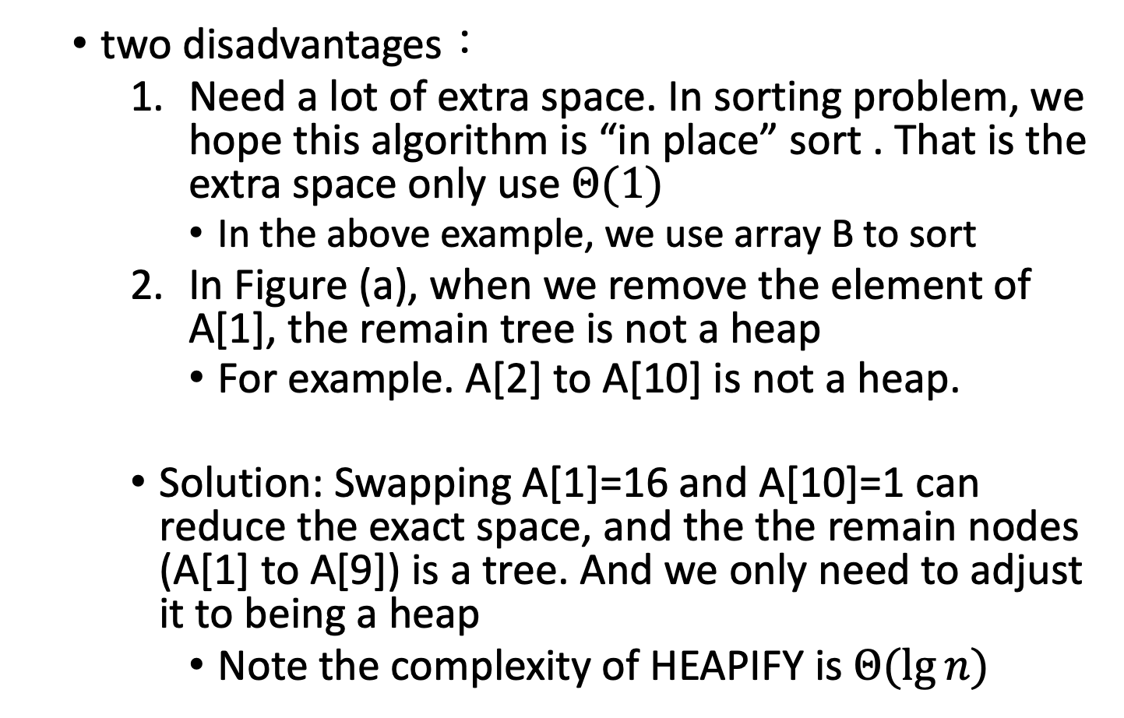
Heap sort
two disadvantages：
Need a lot of extra space. In sorting problem, we hope this algorithm is “in place” sort . That is the extra space only use $Θ(1)$
In the above example, we use array B to sort
In Figure (a), when we remove the element of A[1], the remain tree is not a heap
For example. A[2] to A[10] is not a heap.
Solution: Swapping A[1]=16 and A[10]=1 can reduce the exact space, and the the remain nodes (A[1] to A[9]) is a tree. And we only need to adjust it to being a heap
Note the complexity of HEAPIFY is $Θ(\lg{n})$

Slide 26
Example of HEAPIFY
Example i = 2
HEAPIFY(A, 2)
1
16
2
i
3
14
10
4
5
6
7
8
7
9
3
8
9
10
2
4
1
1
16
2
3
Swap the largest of the three blanks with the parent node above
i
10
4
5
6
7
9
3
8
9
10
2
4
1

Slide 27
Example of HEAPIFY
1
HEAPIFY(A, 2)
Then HEAPIFY(A, 4)
16
2
i
3
10
4
5
6
7
9
3
8
9
10
2
4
1
1
16
2
3
14
10
Swap the largest of the three blanks with the parent node above
4
i
5
6
7
7
9
3
8
9
10
1

Slide 28
Another Example of HEAPIFY
Example i = 1
1
11
2
i
3
20
10
4
5
6
7
15
7
9
3
8
9
10
14
4
1

Slide 29
Another Example of HEAPIFY
Step 1. HEAPIFY(A, 1)
1
11
2
3
Swap the largest of the three blanks with the parent node above
20
i
10
4
5
6
7
15
7
9
3
8
9
10
14
4
1
1
20
2
i
3
11
10
4
5
6
7
15
7
9
3
8
9
10
14
4
1

Slide 30
Another Example of HEAPIFY
Step 2. HEAPIFY(A, 2)
1
20
2
3
Swap the largest of the three blanks with the parent node above
11
i
10
4
5
6
7
15
7
9
3
8
9
10
14
4
1
1
20
2
i
3
15
10
4
5
6
7
11
7
9
3
8
9
10
14
4
1

Slide 31
Another Example of HEAPIFY
Step 3. HEAPIFY(A, 4)
1
20
2
3
Swap the largest of the three blanks with the parent node above
15
i
10
4
5
6
7
11
7
9
3
8
9
10
14
4
1
1
20
2
i
3
15
10
4
5
6
7
14
7
9
3
8
9
10
11
4
1

Slide 32
Another Example of HEAPIFY
Though Steps 1 to 3, we obtain a heap tree
1
20
2
i
3
15
10
4
5
6
7
14
7
9
3
8
9
10
11
4
1

Slide 33
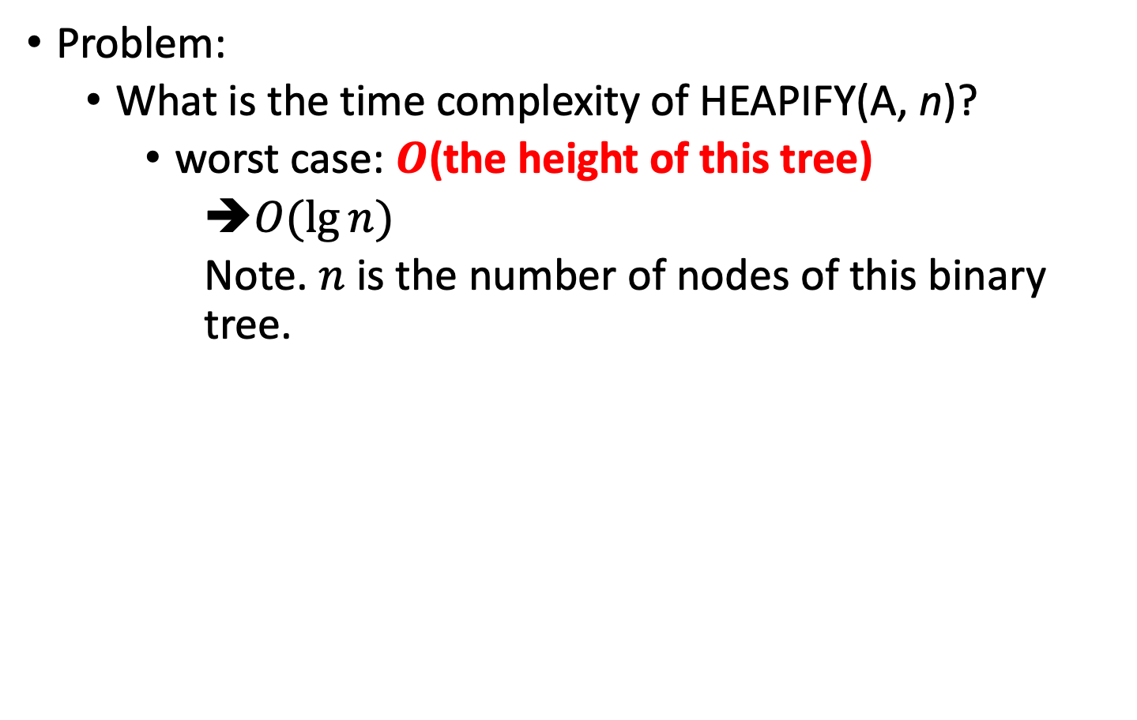
Time Complexity
Problem:
What is the time complexity of HEAPIFY(A, n)?
worst case: $O$(the height of this tree)
$O(\lg{n})$
Note. $n$ is the number of nodes of this binary tree.

Slide 34
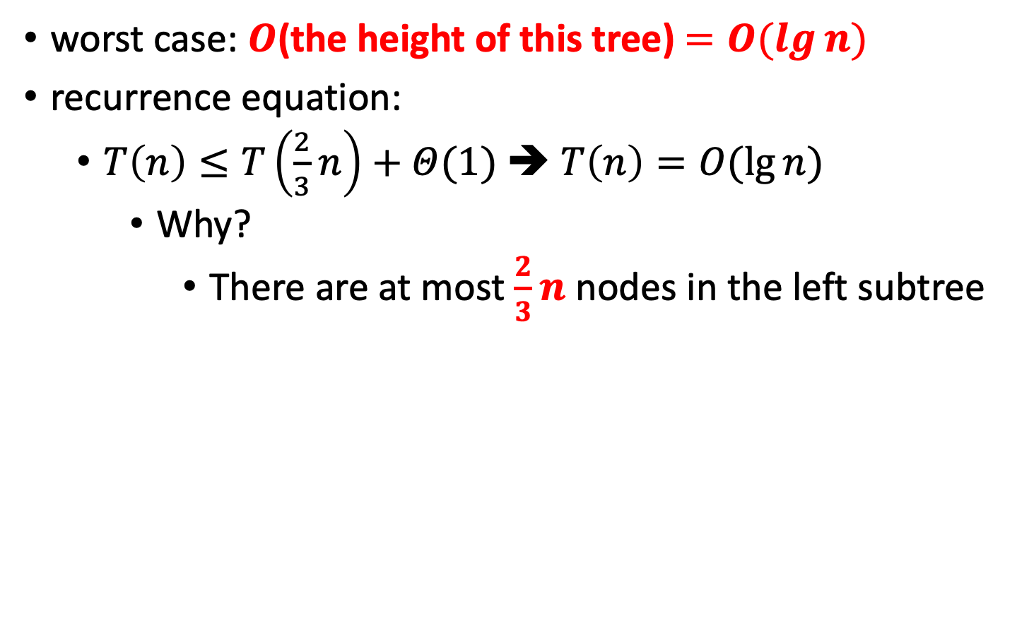
Time Complexity
worst case: $O$(the height of this tree) $=O(\lg{n})$
recurrence equation:
$T\left(n\right)≤T\left(\frac{2}{3}n\right)+Θ(1)$ ➔ $T\left(n\right)=O(\lg{n})$
Why?
There are at most $\frac{2}{3}n$ nodes in the left subtree
left subtree

Slide 35
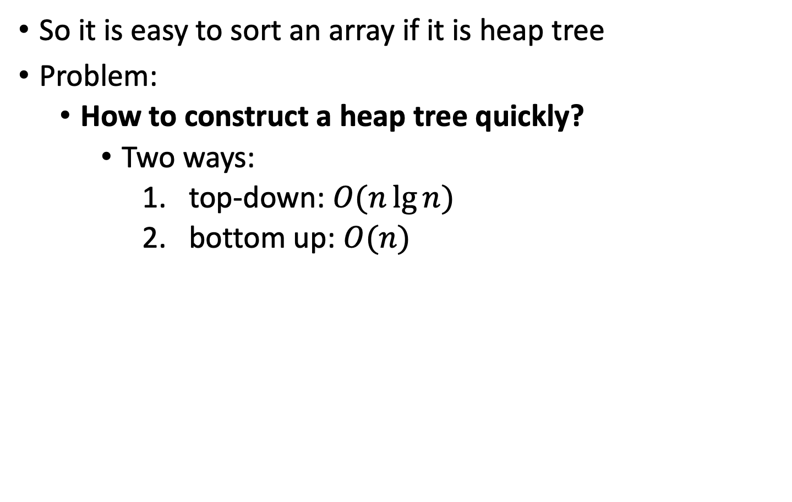
Construct a Heap Tree
So it is easy to sort an array if it is heap tree
Problem:
How to construct a heap tree quickly?
Two ways:
top-down: $O(n\lg{n})$
bottom up: $O(n)$

Slide 36
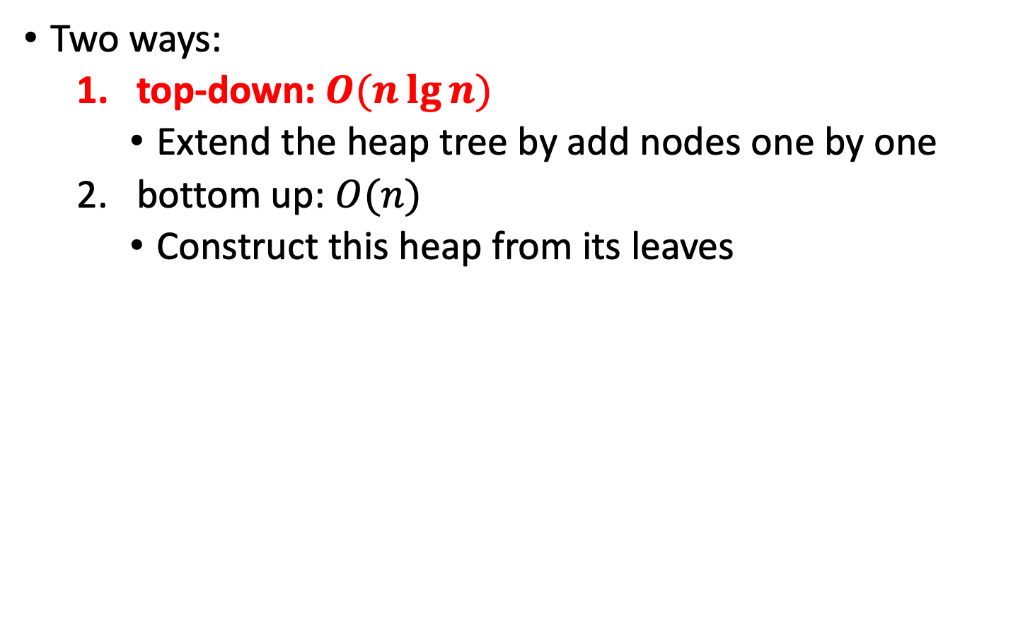
Construct a Heap Tree
Two ways:
top-down: $O(n\lg{n})$
Extend the heap tree by add nodes one by one
bottom up: $O(n)$
Construct this heap from its leaves

Slide 37
Example of top-down
 | 1 | 2 | 3 | 4 | 5 | 6 | 7 | 8 | 9 | 10
A | 4 | 1 | 3 | 2 | 16 | 9 | 10 | 14 | 8 | 7
Top-down (from left to right)
Heap A[1] first, then we check A[1], A[2]
heap: the parent node is great then its children
After we heap A[1], A[2], and A[3], we check A[1], A[2], A[3], and A[4]

Slide 38
Example of top-down
 | 1 | 2 | 3 | 4 | 5 | 6 | 7 | 8 | 9 | 10
A | 4 | 1 | 3 | 2 | 16 | 9 | 10 | 14 | 8 | 7
Top-down (from left to right)
Then we check A[1] ~ A[5]
Since the value of A[5] is large then its parent, we “floating up” it
Swap it with its parent
From down to up

Slide 39
Example of top-down
Top-down (from left to right)
Then we add A[6] to this tree and do “floating up”
Then we add A[7] to this tree and do “floating up”
Then we add A[8] to this tree and do “floating up”
Then we add A[9] to this tree and do “floating up”
Then we add A[10] to this tree and do “floating up”

Slide 40
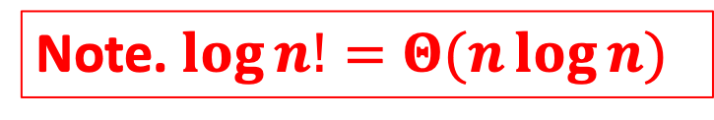
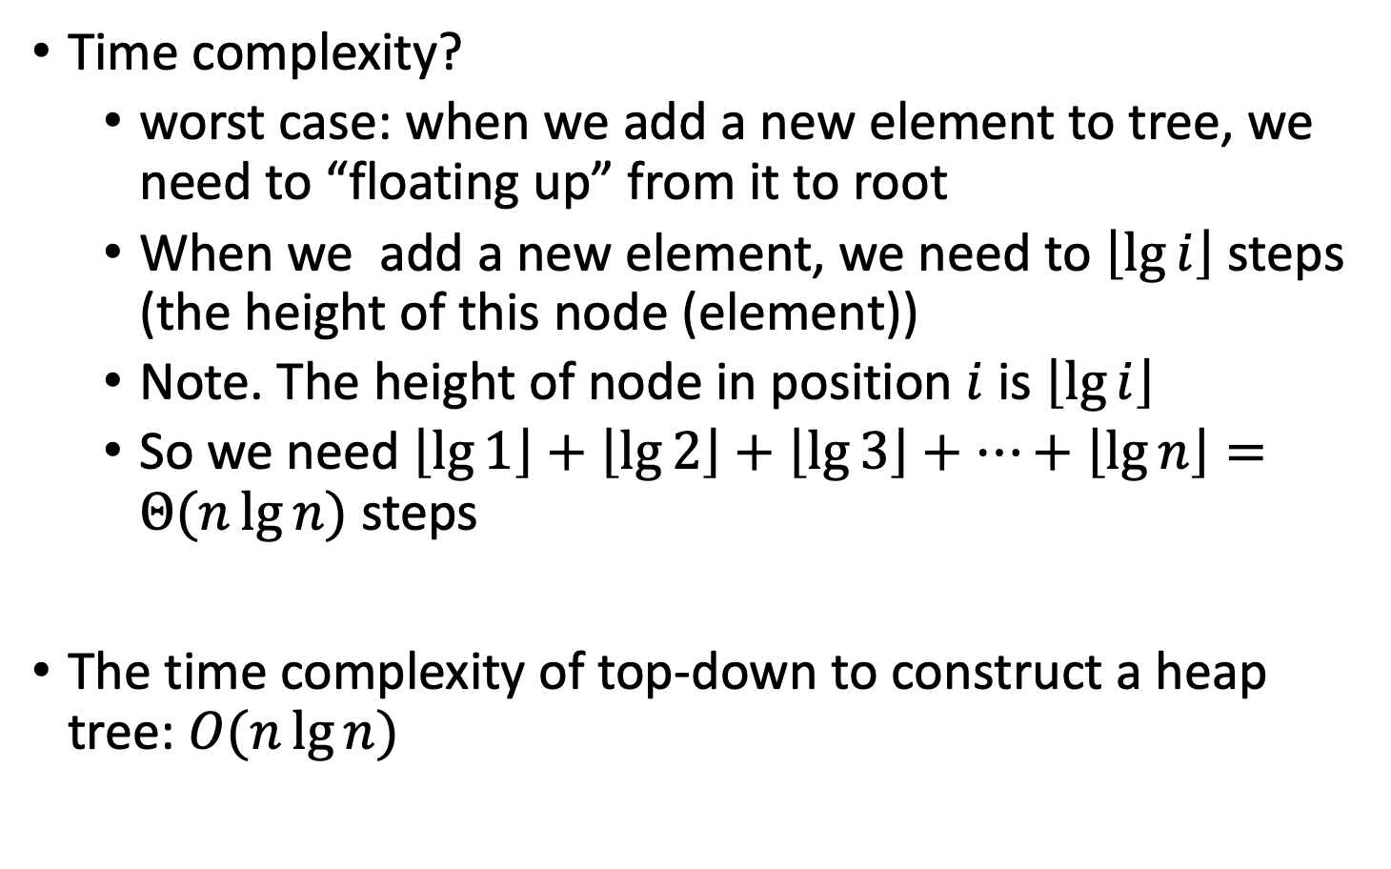
Example of top-down
Time complexity?
worst case: when we add a new element to tree, we need to “floating up” from it to root
When we add a new element, we need to $\left\lfloor \lg{i}\right\rfloor$ steps (the height of this node (element))
Note. The height of node in position $i$ is $\left\lfloor \lg{i}\right\rfloor$
So we need $\left\lfloor \lg{1}\right\rfloor +\left\lfloor \lg{2}\right\rfloor +\left\lfloor \lg{3}\right\rfloor +…+\left\lfloor \lg{n}\right\rfloor =Θ(n\lg{n})$ steps
The time complexity of top-down to construct a heap tree: $O(n\lg{n})$
Note. $\log{n!}=Θ(n\log{n})$

Slide 41
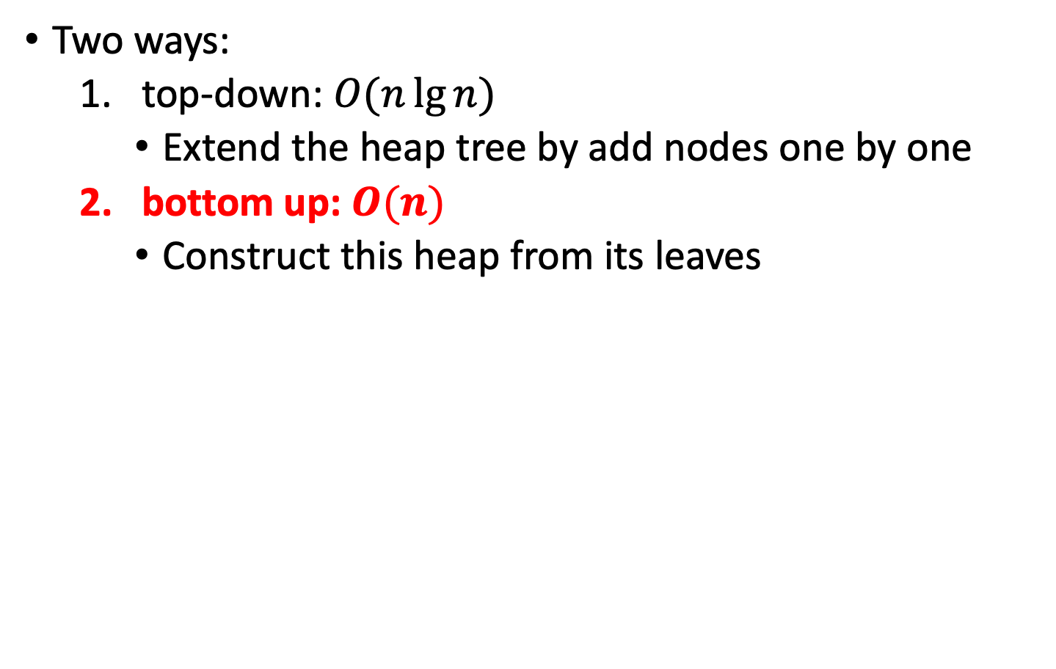
Construct a Heap Tree
Two ways:
top-down: $O(n\lg{n})$
Extend the heap tree by add nodes one by one
bottom up: $O(n)$
Construct this heap from its leaves

Slide 42
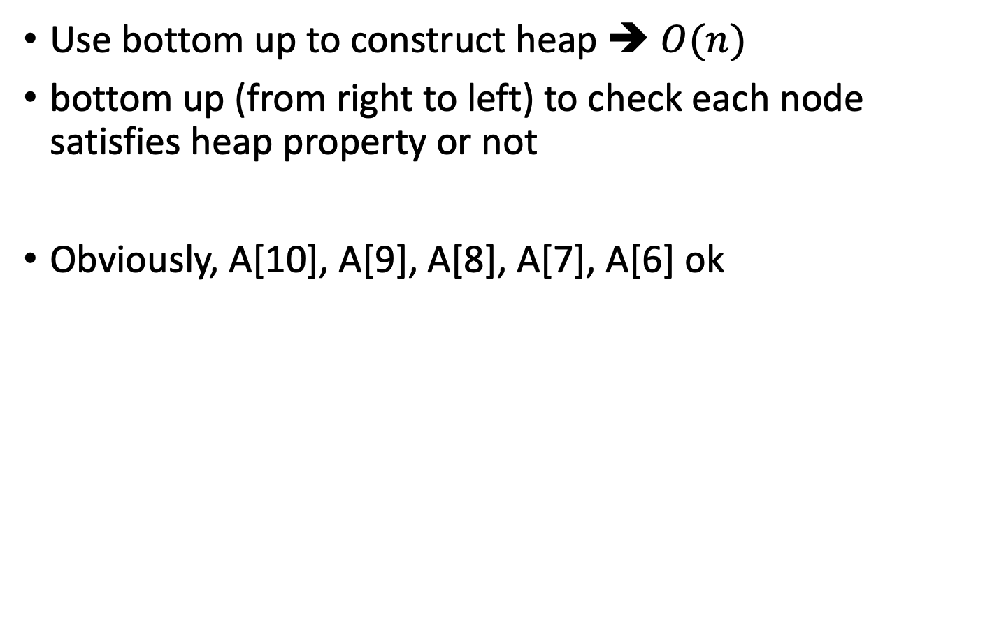
Example of bottom up
Use bottom up to construct heap ➔ $O(n)$
bottom up (from right to left) to check each node satisfies heap property or not
Obviously, A[10], A[9], A[8], A[7], A[6] ok
 | 1 | 2 | 3 | 4 | 5 | 6 | 7 | 8 | 9 | 10
A | 4 | 1 | 3 | 2 | 16 | 9 | 10 | 14 | 8 | 7

Slide 43
Example of bottom up
Check A[5] “sinking down” HEAPIFY(A,5)
Check A[4] “sinking down” HEAPIFY(A,4)

Slide 44
Example of bottom up
Check A[3] “sinking down” HEAPIFY(A,3)
Check A[2] “sinking down” HEAPIFY(A,2)

Slide 45
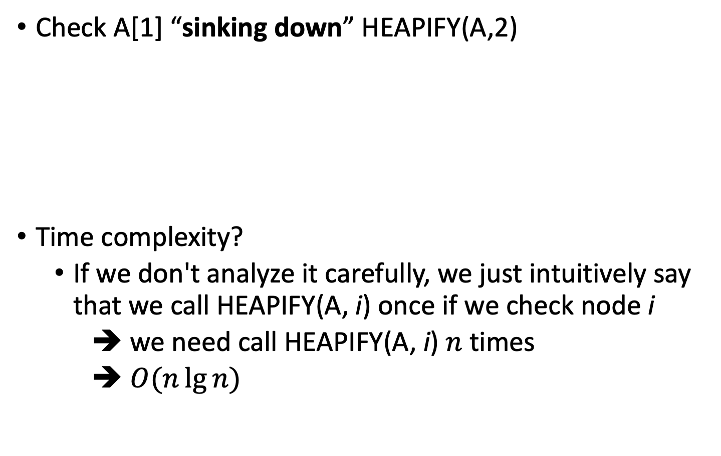
Example of bottom up
Check A[1] “sinking down” HEAPIFY(A,2)
Time complexity?
If we don't analyze it carefully, we just intuitively say that we call HEAPIFY(A, i) once if we check node i
➔ we need call HEAPIFY(A, i) $n$ times
➔ $O(n\lg{n})$

Slide 46
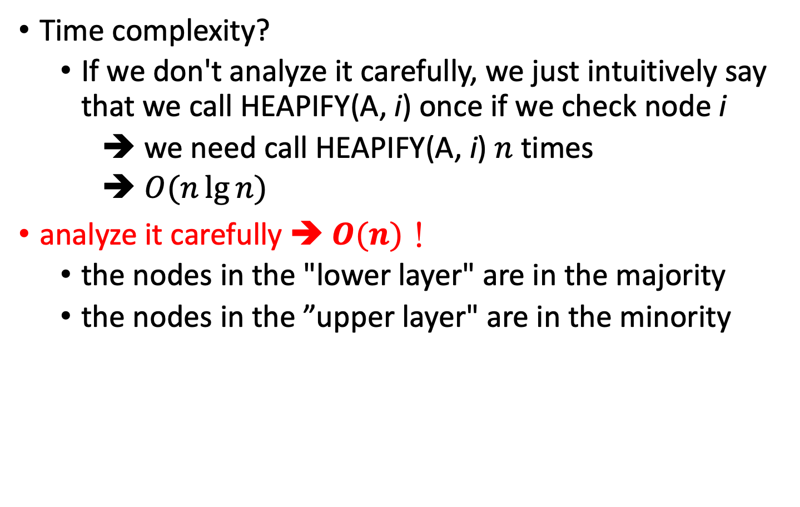
Example of bottom up
Tighter analysis
Tighter bound
Time complexity?
If we don't analyze it carefully, we just intuitively say that we call HEAPIFY(A, i) once if we check node i
➔ we need call HEAPIFY(A, i) $n$ times
➔ $O(n\lg{n})$
analyze it carefully ➔ $O(n)$！
the nodes in the "lower layer" are in the majority
the nodes in the ”upper layer" are in the minority
less
more

Slide 47
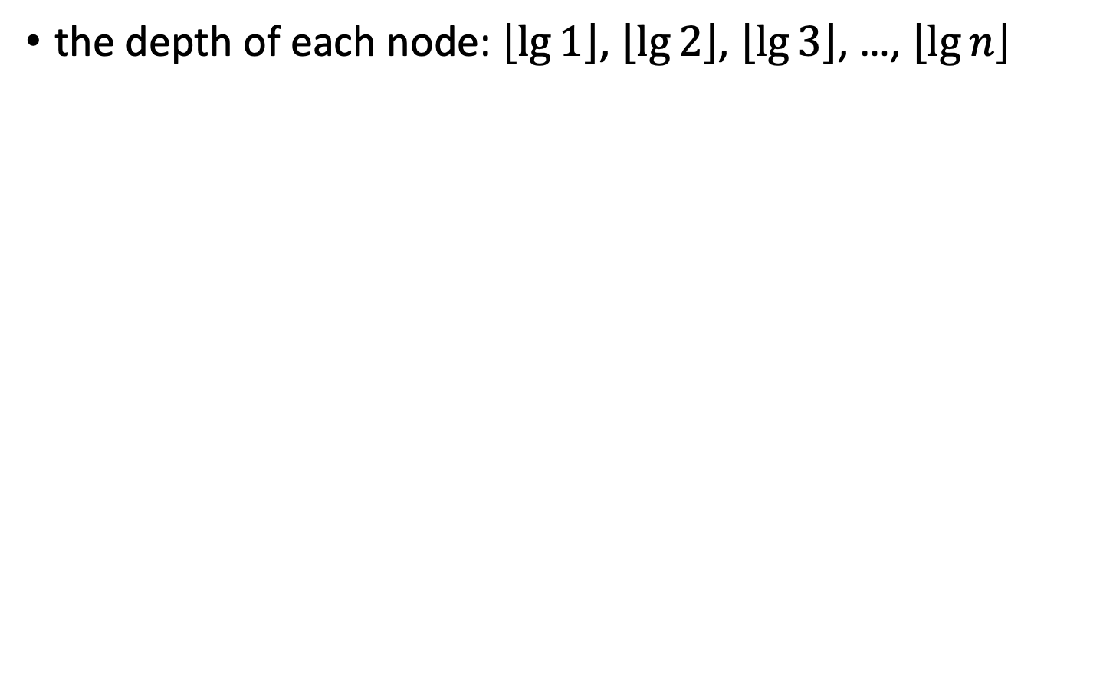
Example of bottom up
the depth of each node: $\left\lfloor \lg{1}\right\rfloor$, $\left\lfloor \lg{2}\right\rfloor$, $\left\lfloor \lg{3}\right\rfloor$, …, $\left\lfloor \lg{n}\right\rfloor$

Slide 48
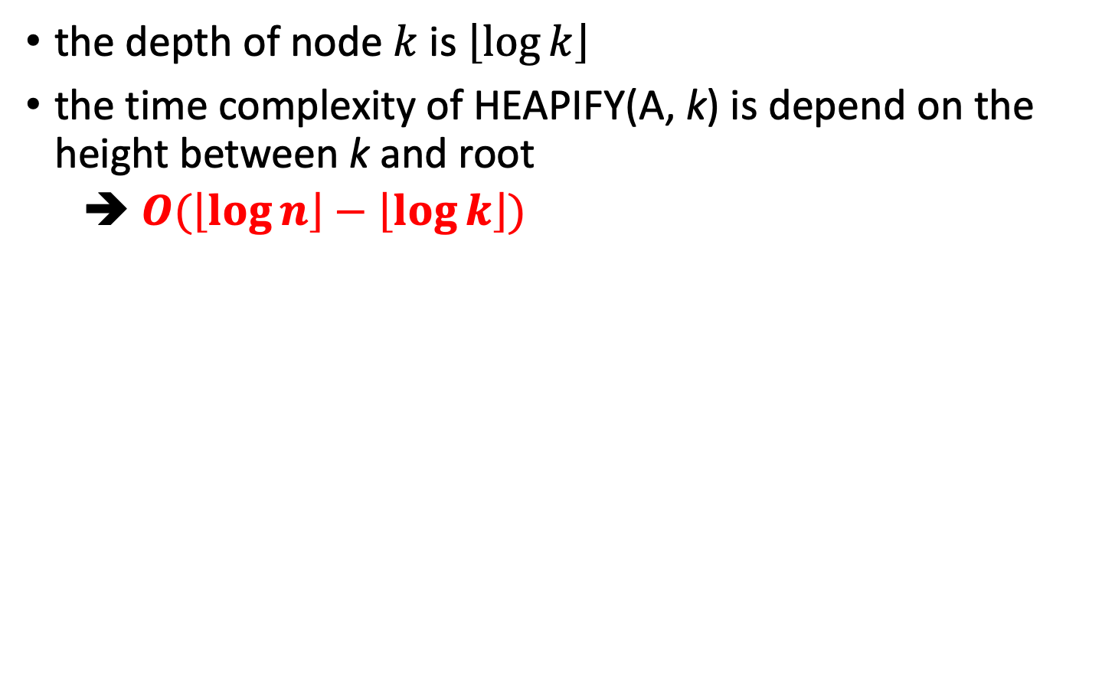
Example of bottom up
the depth of node $k$ is $\left\lfloor \log{k}\right\rfloor$
the time complexity of HEAPIFY(A, k) is depend on the height between k and root
➔ $O(\left\lfloor \log{n}\right\rfloor −\left\lfloor \log{k}\right\rfloor )$

Slide 49
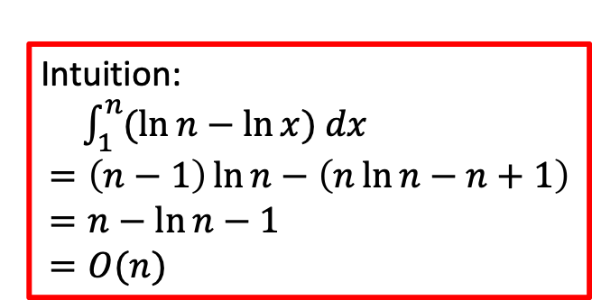
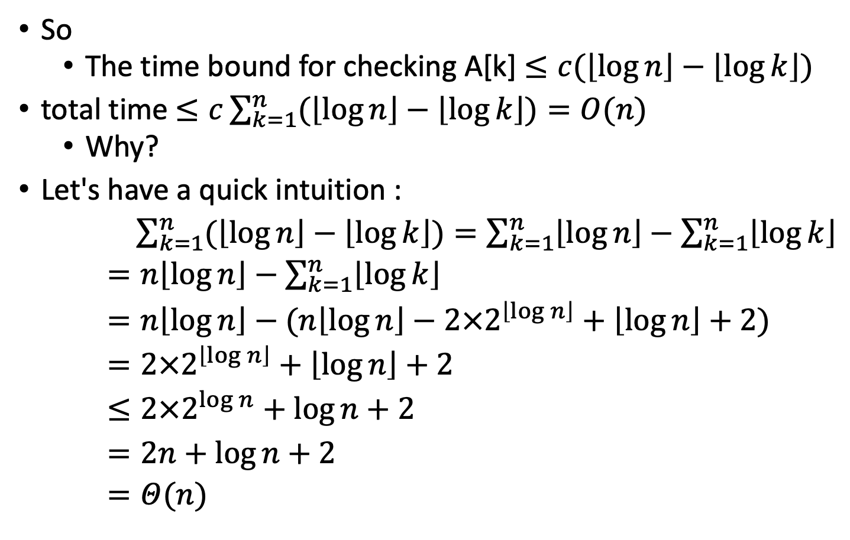
Example of bottom up
So
The time bound for checking A[k] $≤c(\left\lfloor \log{n}\right\rfloor −\left\lfloor \log{k}\right\rfloor )$
total time $≤c\sum_{k=1}^{n}{(\left\lfloor \log{n}\right\rfloor −\left\lfloor \log{k}\right\rfloor )}=O(n)$
Why?
Let's have a quick intuition :
$\sum_{k=1}^{n}{(\left\lfloor \log{n}\right\rfloor −\left\lfloor \log{k}\right\rfloor )}=\sum_{k=1}^{n}{\left\lfloor \log{n}\right\rfloor }−\sum_{k=1}^{n}{\left\lfloor \log{k}\right\rfloor }$
$=n\left\lfloor \log{n}\right\rfloor −\sum_{k=1}^{n}{\left\lfloor \log{k}\right\rfloor }$
$=n\left\lfloor \log{n}\right\rfloor −(n\left\lfloor \log{n}\right\rfloor −2×2^{\left\lfloor \log{n}\right\rfloor }+\left\lfloor \log{n}\right\rfloor +2)$
$=2×2^{\left\lfloor \log{n}\right\rfloor }+\left\lfloor \log{n}\right\rfloor +2$
$≤2×2^{\log{n}}+\log{n}+2$
$=2n+\log{n}+2$
$=Θ(n)$
Intuition:
$\int_{1}^{n}{(\ln{n}−\ln{x}) dx}$
$=\left(n−1\right)\ln{n}−\left(n\ln{n}−n+1\right)$
$=n−\ln{n}−1$
$=O(n)$

Slide 50
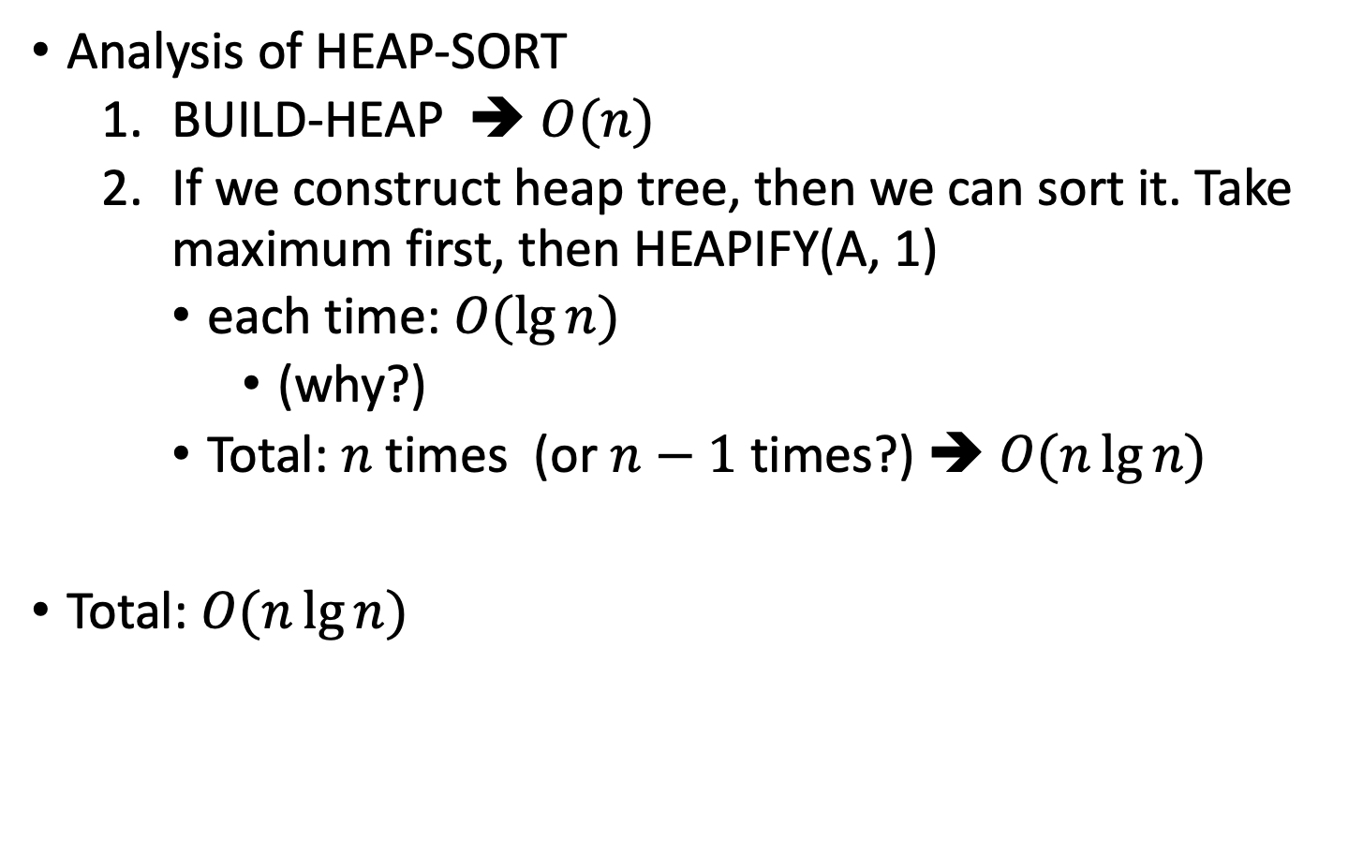
Example of bottom up
Analysis of HEAP-SORT
BUILD-HEAP ➔ $O(n)$
If we construct heap tree, then we can sort it. Take maximum first, then HEAPIFY(A, 1)
each time: $O(\lg{n})$
(why?)
Total: $n$ times (or $n−1$ times?) ➔ $O(n\lg{n})$
Total: $O(n\lg{n})$

Slide 51
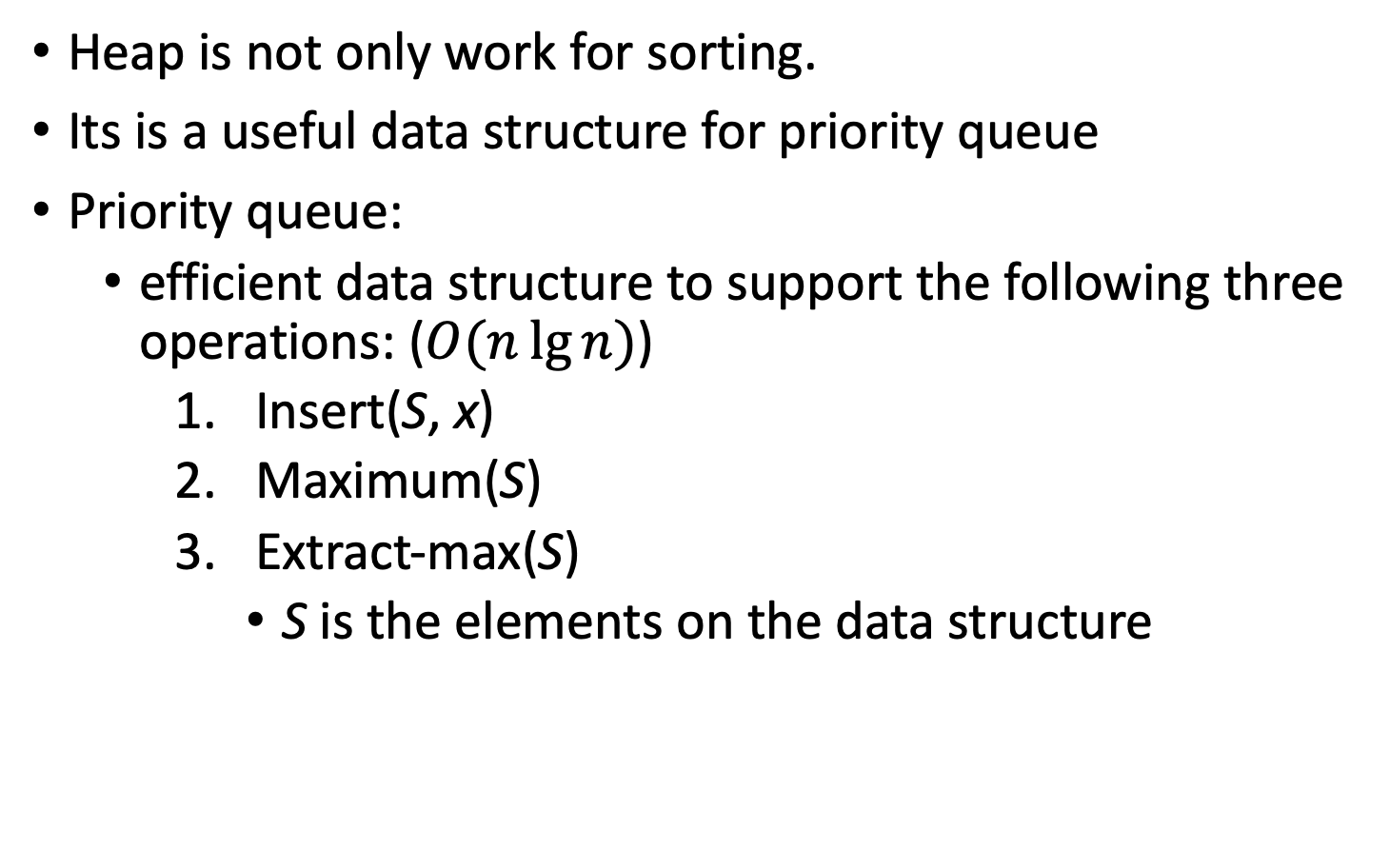
Priority queue
Heap is not only work for sorting.
Its is a useful data structure for priority queue
Priority queue:
efficient data structure to support the following three operations: ($O(n\lg{n})$)
Insert(S, x)
Maximum(S)
Extract-max(S)
S is the elements on the data structure

Slide 52
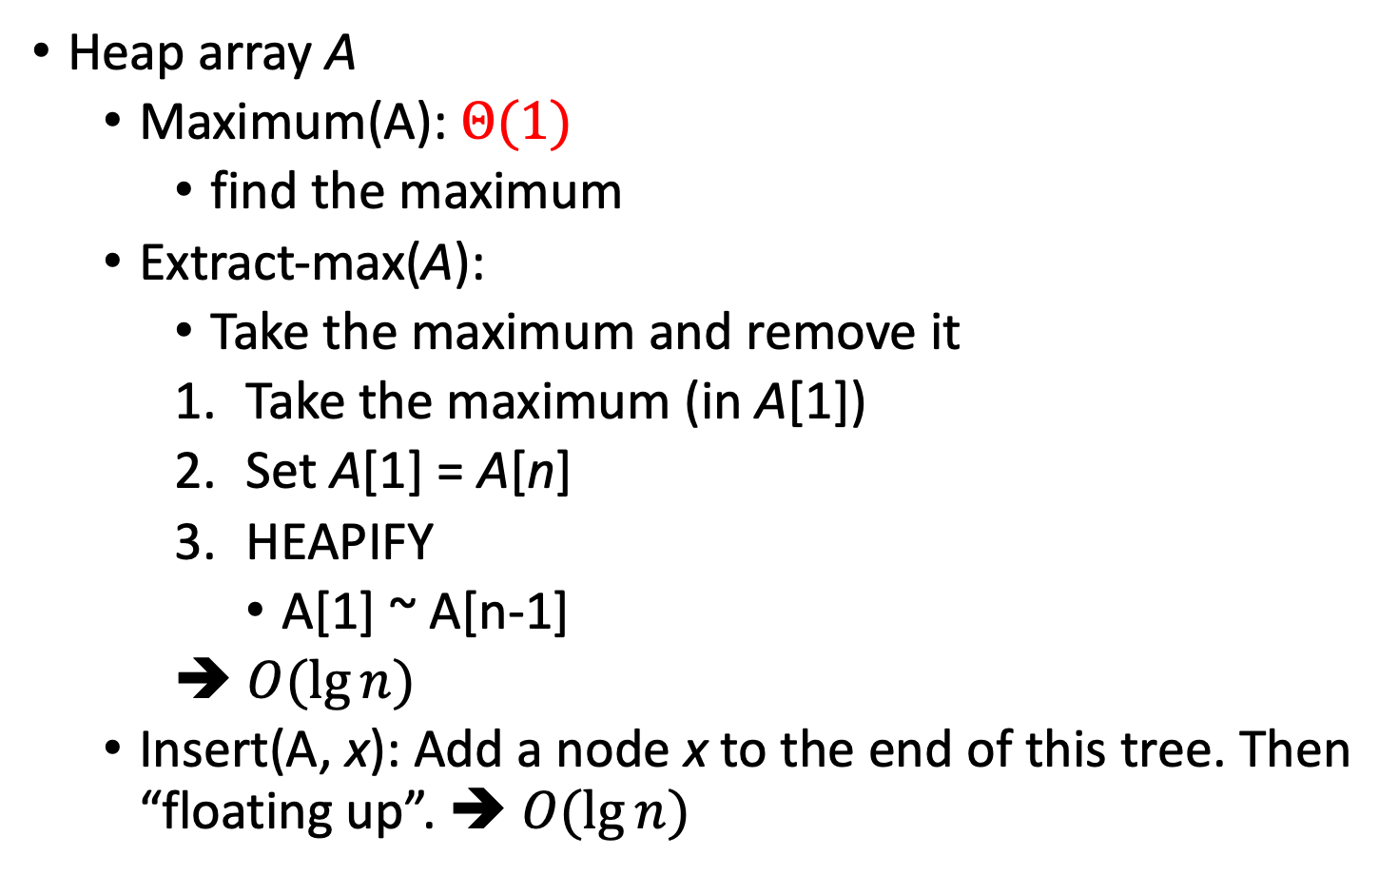
Priority queue
Heap array A
Maximum(A): $Θ(1)$
find the maximum
Extract-max(A):
Take the maximum and remove it
Take the maximum (in A[1])
Set A[1] = A[n]
HEAPIFY
A[1] ~ A[n-1]
➔ $O(\lg{n})$
Insert(A, x): Add a node x to the end of this tree. Then “floating up”. ➔ $O(\lg{n})$

